Slide 1
Design and Development of Payment Operated Automatic Paper Glass Fed Liquid Dispenser Machine
Prateek Shamprasad Pawar(2015BME002)
Prasad Shamrao Deshpande(2015BME016)
Bhagwan Panditrao Savandkar(2015BME017)
Niranjan Mohan Mane(2015BME032)
Manthan Nitin Dhisale(2015BME051)
Under the Guidance of Prof.P.B.Chougule

Slide 2
Introduction
History of Vending machine
Types of Vending Machine
Need of Water Vending Machine

Slide 3
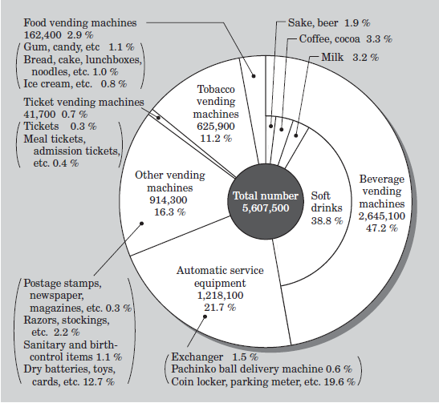
Literature Review
According to survey conducted in Asia- Pacific region by Vending Machine Manufacturers Association (VMMA)

Slide 4
LITRATURE RIEVIEW
Graffen berger patented a cup-dispensing mechanism for the addressed issue. This invention relates to dispensing means and more particularly to a cup dispensing machine.
Alfonso Carlosena et al. describe about different coin accepting sensors include optical sensors, electromagnetic sensor, impact sensor, acoustic sensor.
BUISNESS MODEL PROPOSED BY MANOHAR BHARATThere should be an Automated Vending Machine at every village with more than 5000 populations in Haryana which have at-least 8 hours of electricity per day (irrespective of timings) There need to be at least 1 and maximum 2 local agents in that village.

Slide 5
objectives
To study different mechanical and electronic principles involved in the automation project.
To select appropriate sensors and actuators for constructing various mechanisms involved in the automation project.
To design and fabricate mechanisms for metering and automatic feeding for the workable prototype.
To execute a proper algorithm based program for Arduino controlled sensors and actuators for the intended application.

Slide 6
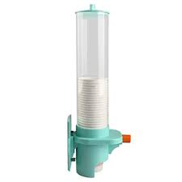
Ideation
Payment Methods
Cash payment
Card payment
Upi payment
Cup Sepatating mechanism
Manual separation
Manually operated dispensing mechanism
Automatic mechanism

Slide 7
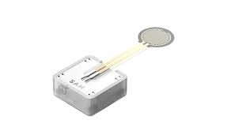
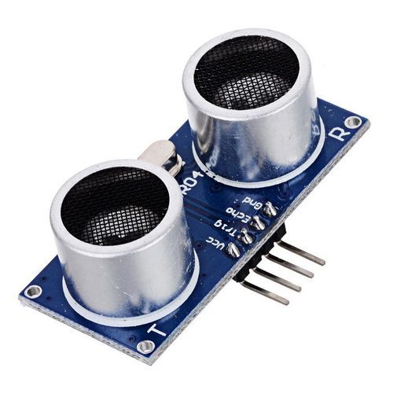
ideation
Water measurement
Weight measuring of cup
Water flow time control
Flow sensor

Slide 8
DESIGN PHASE

Slide 9
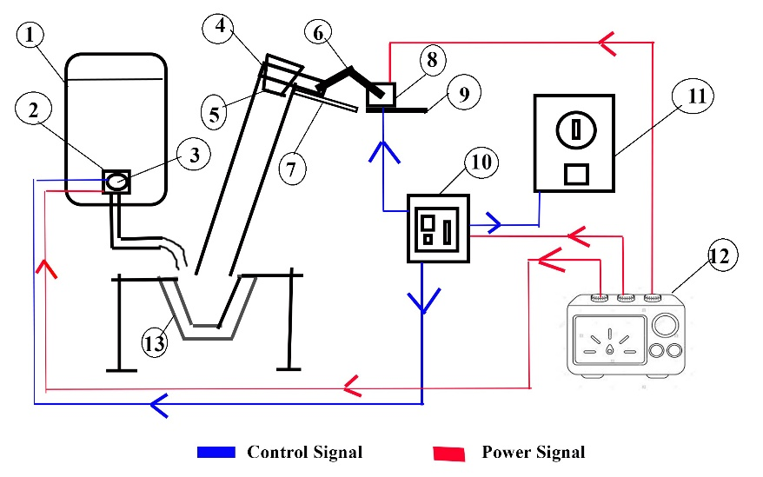
1.Water Dispenser 8. Servomotor
2.Solenoid Valve 9. Motor Support
3.Flow Sensor 10. Embedded Device(Arduino)
4.Recessed Slider 11. Coin Detector
5.Paper Glass 12. Power Supply
6.Linkage 13. Cup holder
7.Guides

Slide 10
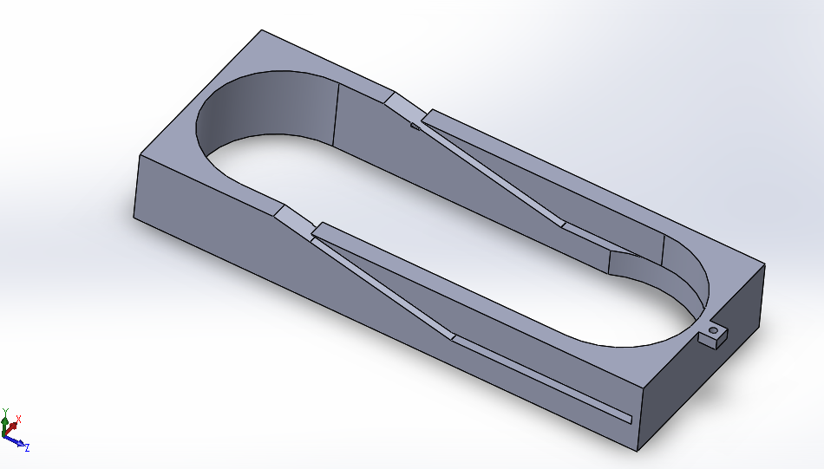
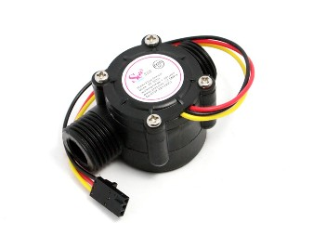
Design
Coin Detector
Metering System
Cup Separator Mechanism:
Servo Motor
Cup Separator

Slide 11
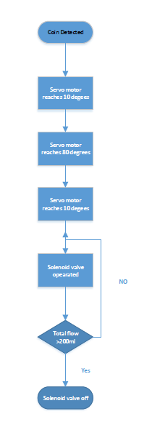
CONTROLING UNIT
Hardware
Software

Slide 12
FABRICATION
Cup separator
Cup separator Mechanism
Sliders for mechanism
Cup stack support

Slide 13
COST ANALYSIS
Item No | Name | Function | Cost(INR)
1 | Arduino Mega | Control System | 1500
2 | 12 V lipo Battery | Power supply | 2500
3 | 3d printing material | Cup dispenser Mechanism | 1500
4 | Servo motor | Cup dispenser Mechanism | 1200
5 | Solenoid Valve | Flow control | 1000
6 | Flow meter | Flow measurement | 800
7 | Coin Detector | Coin detection | 800
8 | Tank1(20 ltr) | Water storage | 200
9 | Tank2(2ltr) | Water storage | 300
10 | Aluminum linkages | Cup dispenser Mechanism | 100
11 | PVC pipe | Cup movement | 100
12 | Steel frame | Cup holder support | 200
13 | Plastic pipe 1/4'' | Water flow | 200
14 | Sliders | Mechanism support | 300
 |  | Total | 10,700

Slide 14
Cost analysis
Case A.
For organisation like Bisleri
Case b
For government organisations like Tata Trusts

Slide 15
COMPArison
BISLERI OR COMMERCIAL ORGANISATIONS | GOVERNMENT SCHEMES OR SWATCHHA JAAL
20 L of water for 90 INR Cost of 1 glass (200 ml) is 0.45 Rs | 20 L of water for 5 INR Cost per 200ml glass of water = 0.25 Rs
Electric overhead charges for 1 Glass of Water=0.000825 Rs | Electric overhead charges for 1 Glass of Water=0.000825 Rs
Maintenance costs per glass of water 0.06667 Rs. | Maintenance costs per glass of water are 0.06667 Rs
Profit margin of 40% (0.58 Rs) | Profit margin of 30% (0.43 Rs)
Cost Price for 1 glass of water 1.4175 Rs | Cost Price for 1 glass of water 0.7675 Rs
Selling price for 1 glass of water= 1 Rs | Selling price for 1 glass of water= 1 Rs

Slide 16
conclusion
AVM
Eco-friendly
Cost effective
Fully Auto
Customizable
Reprogammable

Slide 17
references
https://en.wikipedia.org/wiki/Arduino
https://www.best-microcontroller-projects.com/coin-detector-and-counter.html

Slide 18
THANK YOU

